Slide 1
Understanding U.S. west coast whale entanglements
West Coast Region
Lauren Saez and Dan Lawson
Workshop on Gear Innovations and Practices to Reduce Whale Interactions
March 28-29, 2017
Portland, OR

Slide 2
The concern
Entanglement of marine mammals in fishing gear is a global problem
NMFS has identified large whale entanglement in fishing gear along the US West Coast as a priority management issue
Entanglement reports
Opportunistic sightings from a variety of sources
Underestimate of total entanglements (emaciated whales sink quickly)
Gap in identification of whale species & gear involved
336 whales reported entangled between 2000 and 2016 (California, Oregon, and Washington)
166 Humpbacks, 102 Grays, 6 Fins, 5 Blues, 2 Minke, 2 Sperms, 2 Killer whales, and 50 Unidentified species

Slide 3
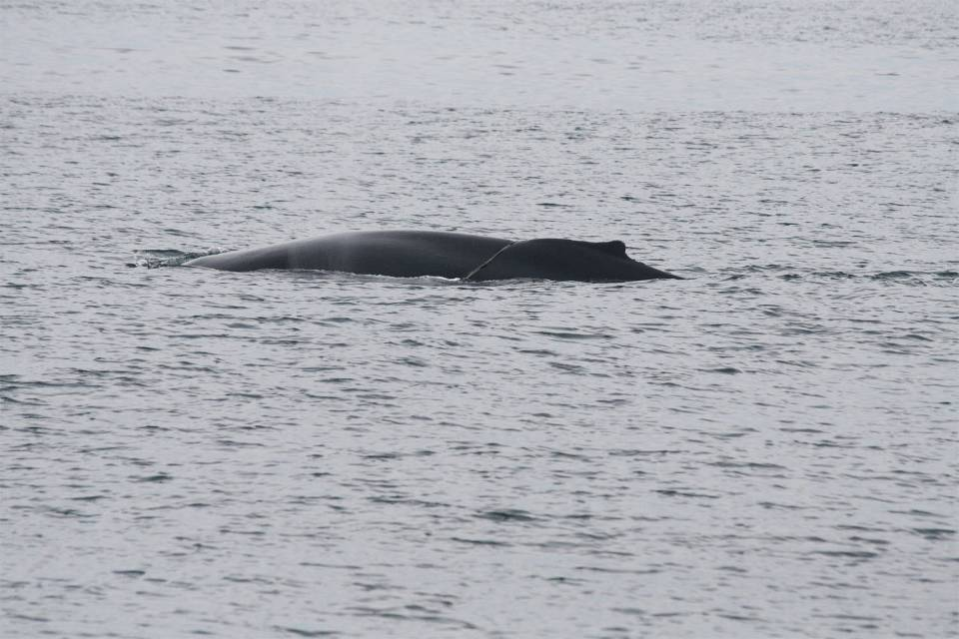
What you see above the water . . .
Provincetown Center for Coastal Studies. WR-2009-09. Taken under NOAA permit 932-1489.
Notes:
No matter how much of an expert you are, limitations to what you can see
3

Slide 4
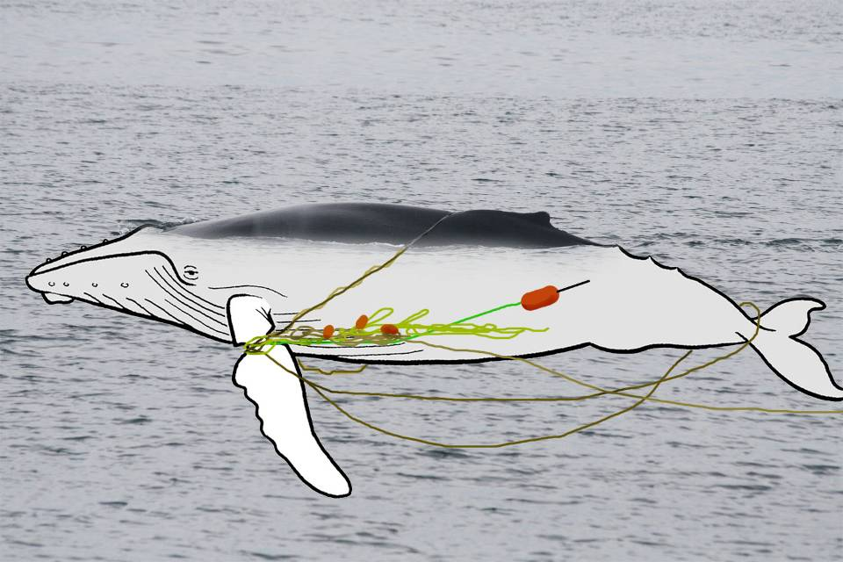
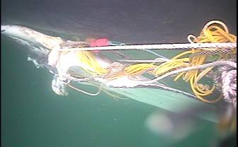
What is really happening . . .
Left flipper
Provincetown Center for Coastal Studies. WR-2008-09. Taken under NOAA permit 932-1489.

Slide 5
Long term trend of whale entanglement reporting
Notes:
Long term trends, averaged about 10 entanglement reports a year till late 2000s, averaging 33 (2014-2016)

Slide 6
What whales are being reported as entangled?

Slide 7
Comparing 1982-2013, 2014, 2015 and 2016: Whale entanglement reports by month
 | Humpback
Month | 82-13 | 2014 | 2015 | 2016
January | 1 | 0 | 2 | 1
February | 1 | 0 | 2 | 2
March | 1 | 0 | 1 | 1
April | 1 | 1 | 0 | 6
May | 11 | 3 | 4 | 8
June | 4 | 3 | 5 | 10
July | 7 | 1 | 5 | 1
August | 20 | 2 | 2 | 12
September | 4 | 7 | 6 | 3
October | 8 | 2 | 6 | 6
November | 5 | 1 | 2 | 1
December | 3 | 0 | 0 | 3
 | Gray
Month | 82-13 | 2014 | 2015 | 2016
January | 26 | 1 | 0 | 0
February | 20 | 0 | 2 | 1
March | 53 | 0 | 4 | 0
April | 50 | 1 | 0 | 2
May | 22 | 2 | 1 | 0
June | 7 | 0 | 0 | 0
July | 9 | 1 | 1 | 0
August | 9 | 0 | 1 | 0
September | 3 | 2 | 2 | 0
October | 4 | 0 | 0 | 0
November | 2 | 0 | 0 | 0
December | 4 | 0 | 1 | 0

Slide 8
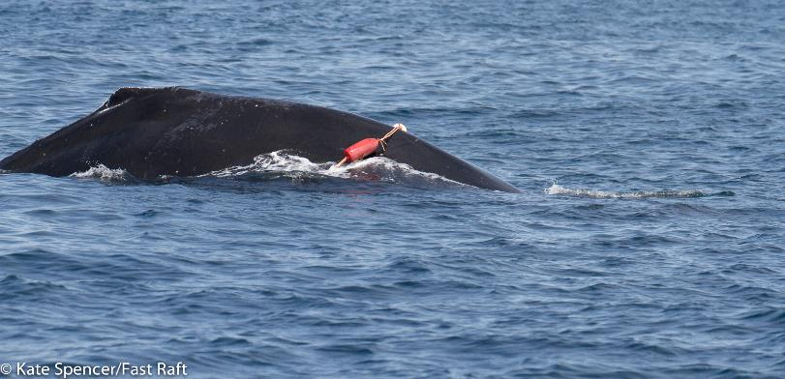
Where are entanglements reported? Note: where entanglement were reported is often not where the whale became entangled
State/Region | 1982-2013 | 2014 | 2015 | 2016
BC Canada | 0 | 0 | 0 | 1*
WA | 30 | 3 | 3 | 0
OR | 24 | 6 | 1 | 1
CA | 278 | 22 | 57 | 66
Mexico | 3 | 0 | 0 | 2*
* Indicates that the entanglement involved gear that was confirmed to be from U.S. Dungeness crab fisheries
NOAA MMHSRP 18786
Notes:
Mainly California is where reports are made
2016

Slide 9
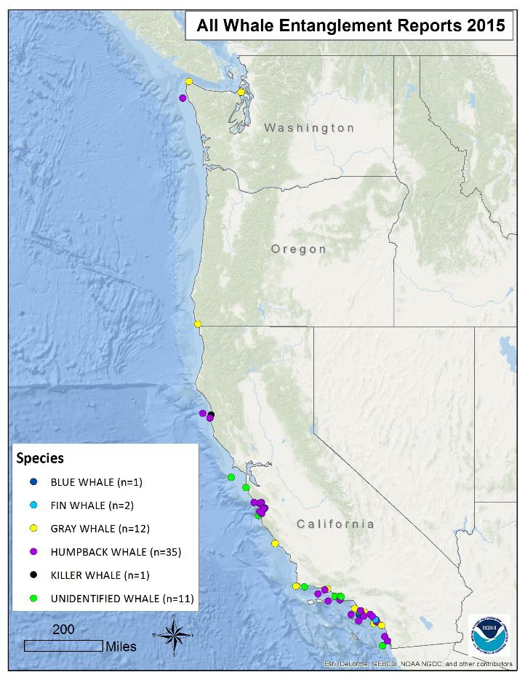
(n=62)
Notes:
2016 had a concentration in Monterey/Central California, notice the entanglements reported from Mexico and Canada

Slide 10
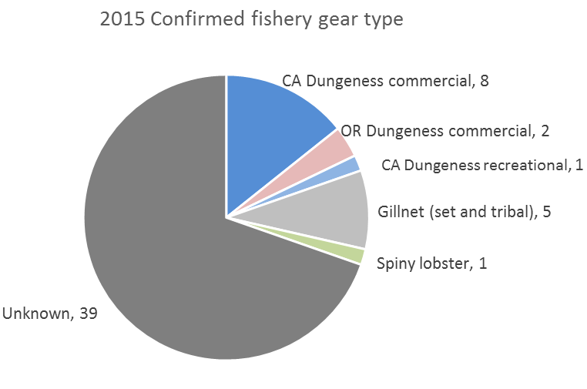
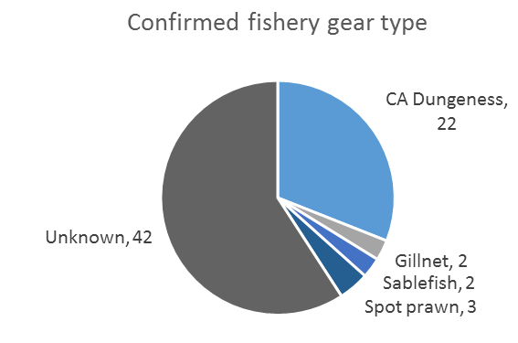
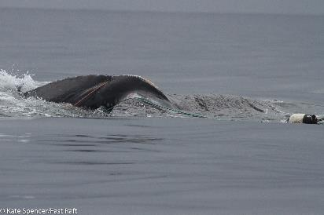
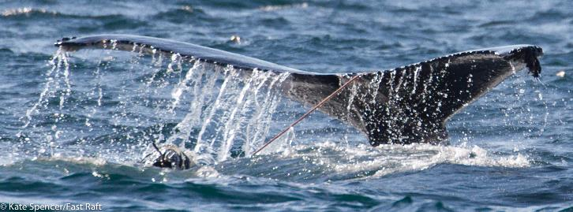
Sources of entanglements 2015 and 2016
2016
NOAA MMHSRP 18786
NOAA MMHSRP 18786
Notes:
Breakdown of sources of entanglement over the past three years. We do get a variation of gear types but Dungeness crab has been more easily identified (gear tags), we are conservative and do not assign anything to a specific fishery unless we are confident. Line only even line with buoys is still an unknown 20160416Mn photos

Slide 11
Comparing report and gear set locations
2015 Dungeness crab entanglements (n=11):
5 cases with similar report and gear set locations
2 cases with long distance between report location and gear set location (gear from Oregon reported on whales in California)
4 cases with unknown set locations (assumed set within California since it had a CDFW tag)
2016 Dungeness crab entanglements (n=22):
5 cases with similar report and gear set locations
3 cases with long distance between report location and gear set location (California gear seen on whales in Canada and Mexico)
2 cases with long distances between gear set and report location, within the same state
12 cases with unknown set locations (assumed set within California since it had a CDFW tag)
NOAA MMHSRP 18786
Notes:
20150516Mn

Slide 12
Confirmed Dungeness crab entanglements by month
Month | 2014 | 2015 | 2016 | Total
January | 0 | 1 | 0 | 1
February | 0 | 1 | 0 | 1
March | 0 | 1 | 0 | 1
April | 1 | 1 | 4 | 6
May | 1 | 2 | 4 | 7
June | 1 | 2 | 5 | 8
July | 0 | 1 | 2 | 3
August | 1 | 0 | 4 | 5
September | 0 | 1 | 0 | 1
October | 0 | 1 | 0 | 1
November | 0 | 0 | 1 | 1
December | 0 | 0 | 2 | 2
Notes:
Timing of Dungeness crab entanglements. Notice the higher numbers over the summer. Late start to the season in 2016- entanglements were reported within a week of crab season opener in California.

Slide 13
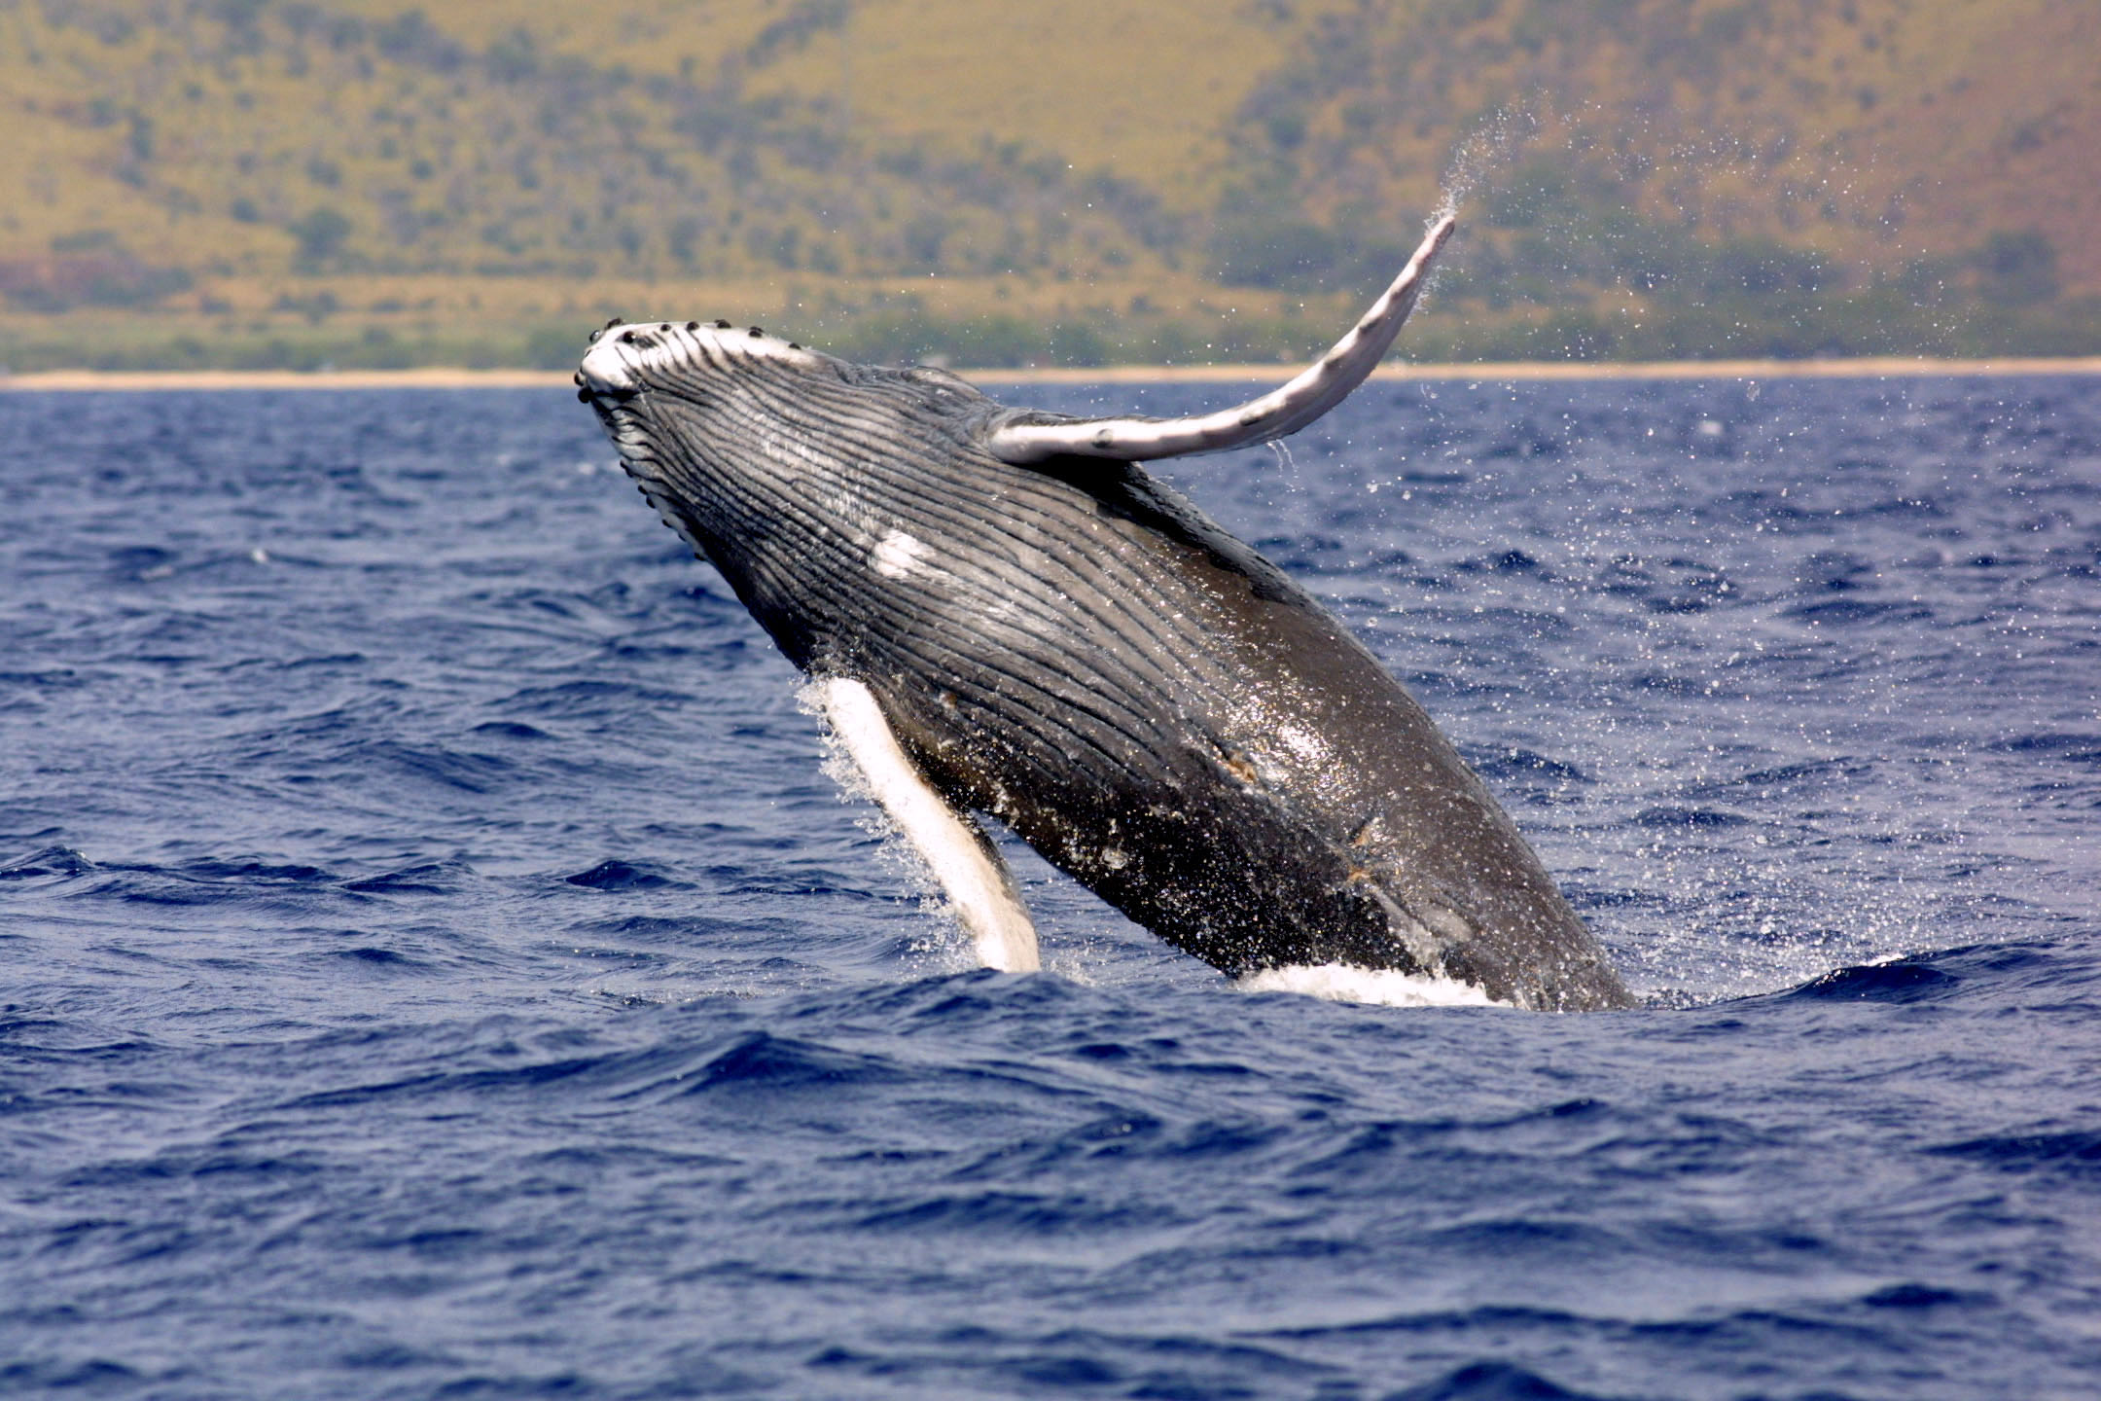
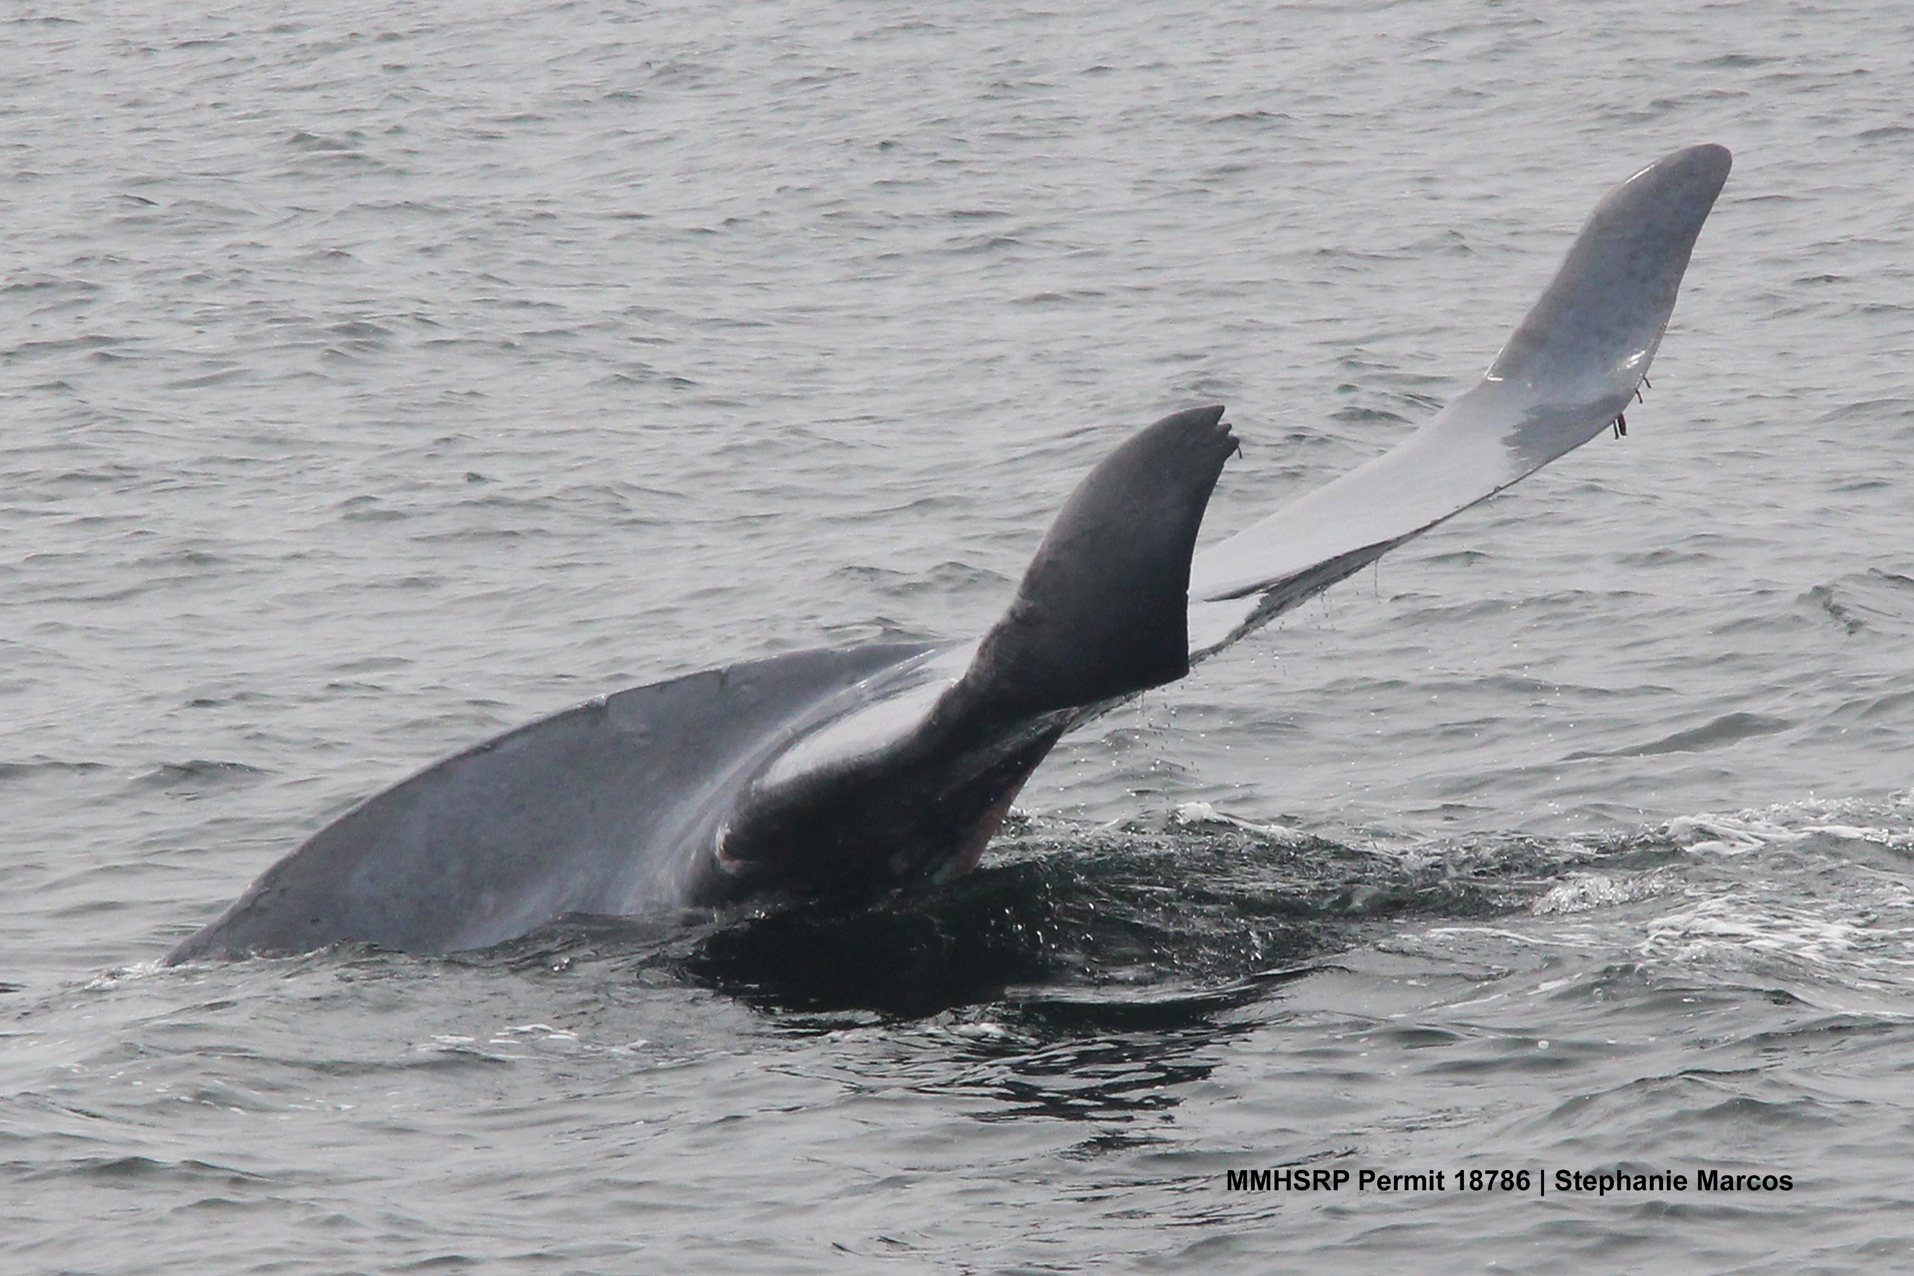
What we know
NMFS West Coast Region is receiving an increasing number of whale entanglement reports (especially Humpbacks)
Potentially contributing factors: increased outreach/awareness, changing distributions/timing of whales and fishing effort (Environmental? Economic?)
Blue whales are being reported as entangled! None reported prior to 2015
Recent (2015-16) increase in entanglements reported in central California (Whale hotspot? Local Awareness?)
Whales can carry gear for long distances
Photo credit: NOAA
NOAA MMHSRP 18786
Notes:
20160714Bm (Cadillac)

Slide 14
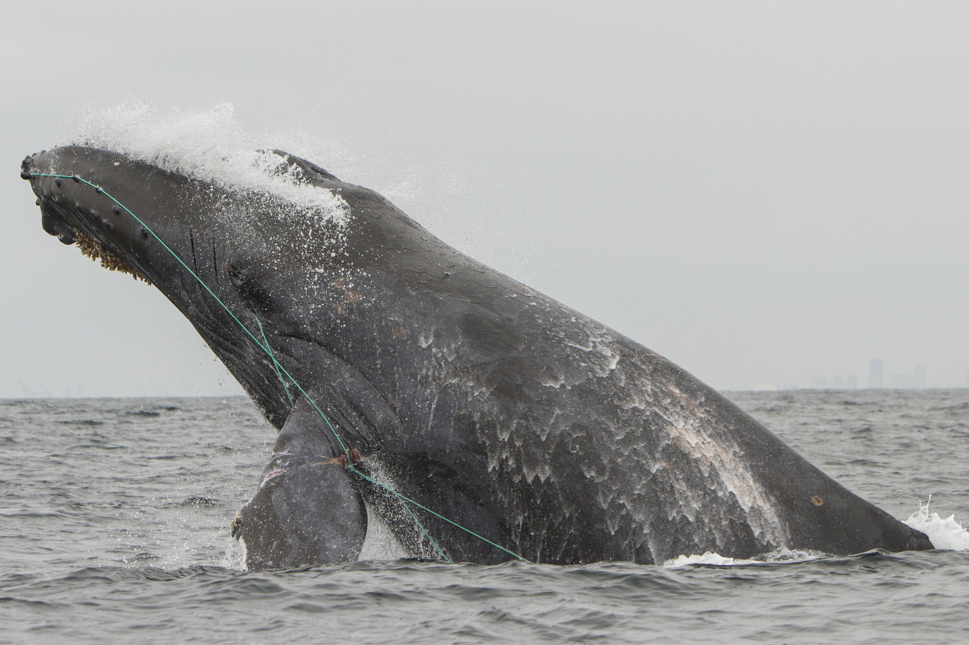
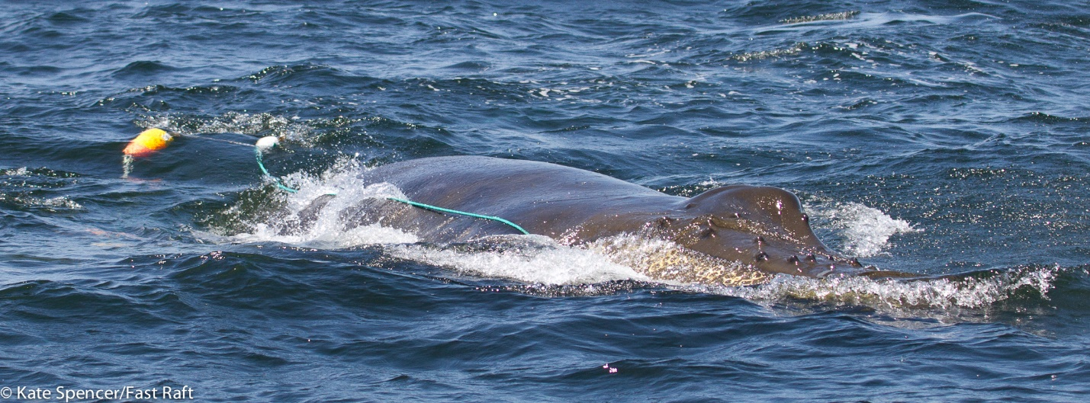
What we know (continued)
More detailed documentation/better reporting and increasing response in recent year has increased ability to identify gear (along with trap tags), but still limited
Trap/pot fisheries are being identified as the majority entangling gear (of identified gear types); commercial Dungeness crab gear has the highest confirmed entanglement reports
Dungeness crab is the largest trap fishery off the west coast with the highest number of participants and number of traps/lines:
Whales are getting entangled every way possible; in mouth/pectoral flippers/tail and in all types/colors of line – not likely to be one easy fix to solve all problems
NOAA MMHSRP 18786
NOAA MMHSRP 18786
Notes:
may not be anything special about crab gear as much as relative extent of overlap in terms of extent of gear in water
20160806Mn
20160522Mn_2

Slide 15
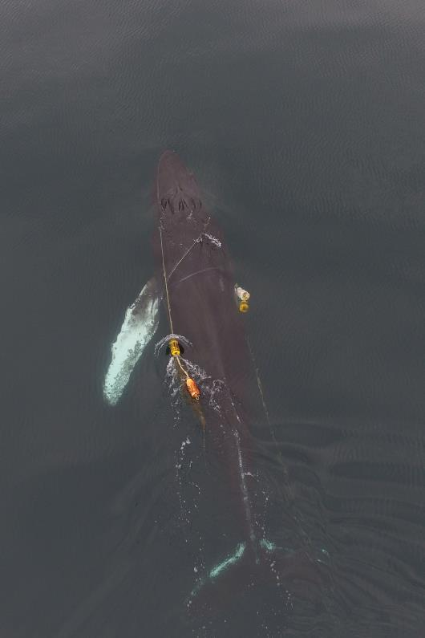
What we don’t know (data gaps)
Entanglement Data
Identifying entanglement origins
Fishery
Set Locations
Timing (where to focus management and research efforts)
Understanding of configurations of gear involved in entanglements
Knowing the total # of entanglements that occur (confirmed reports are minimum estimates)
Understanding how whale behavior and gear configuration factor into increased risk of entanglement
Understanding outcomes of entanglements (long term survival, serious injuries, impacts of reproduction)
NOAA MMHSRP 18786
Notes:
If even a fishery…, location of where whale became entangled
a comment that we recognize that these confirmed reports are minimum estimates of actual entanglements occuring off our coast and that actual # of entanglements is likely much greater than known entanglements.
20161012Mn photo

Slide 16
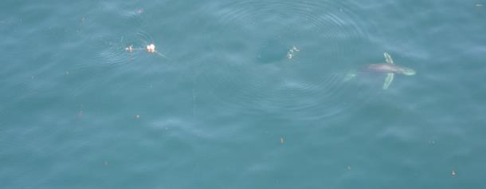
What we don’t know (data gaps)
Whale data
Precise understanding of seasonal/annual variability in whale presence and abundance along the west coast, including factors that influence that variability (prey availability, water temperatures, etc.)
Fishery Data
Precisely where and when (spatial and temporal) crab gear is distributed across the west coast, along with factors that influence variability
Knowledge of how crab gear is configured across the west coast
General knowledge of recreational crab fishery
Solutions
Effectiveness of ideas to reduce risk
are not necessarily clear
Evaluation of innovations in terms of reducing
entanglements may be difficult
Require time and coordination across
west coast
NOAA MMHSRP 18786
Notes:
20160926Mn photo

Slide 17
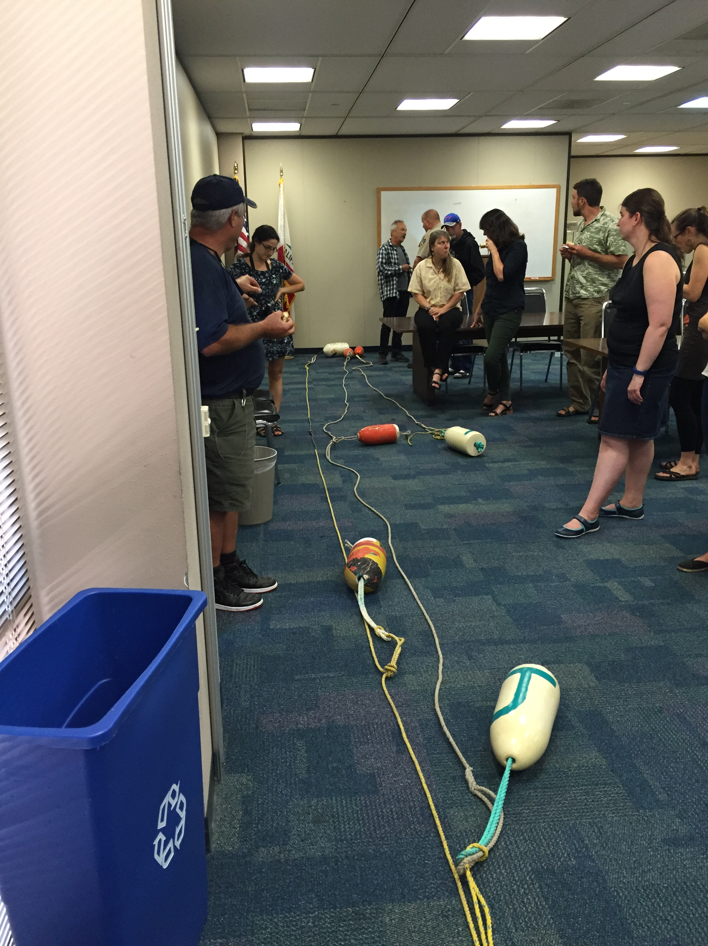
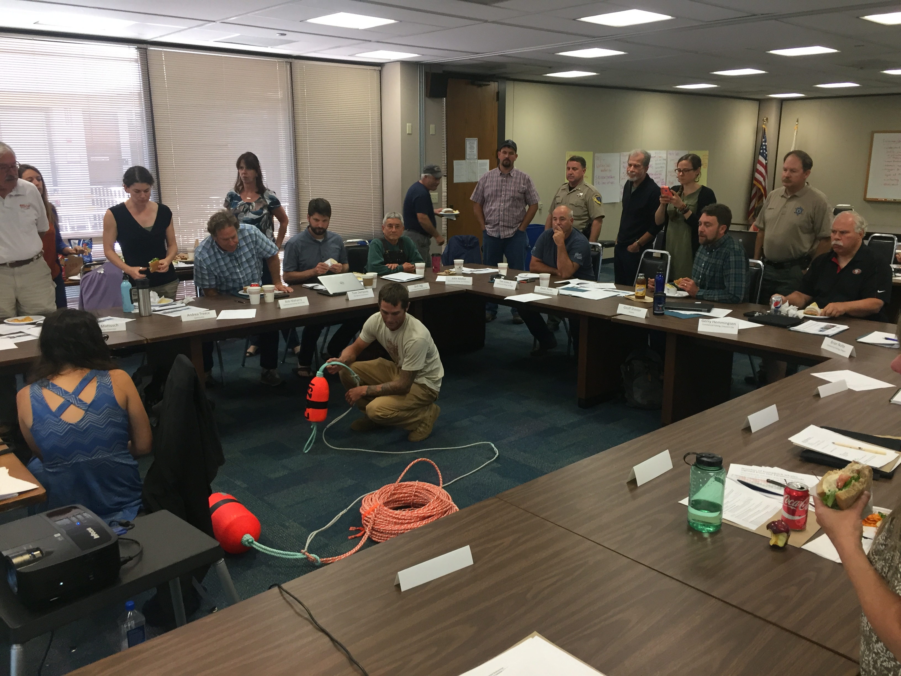
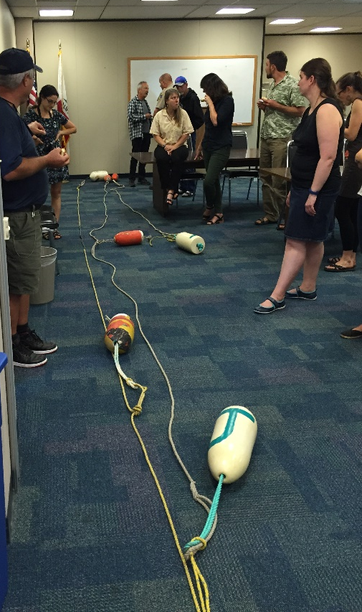
What are we doing?
Extensive outreach on the entanglement issue across the west coast; response training
Supporting initiatives such as the California Dungeness Crab Whale Entanglement Working Group (started in 2015)
Develop recommendations for industry and management (e.g. Best Practices Guide)
Promote gear research, enhanced data collection analysis
Review/analysis of whale entanglement documentation
Working to provide/facilitate scientific expertise and developing tools that can be used by industry, States, others, to help understand and address this issue (e.g. whale models)
Funding (BREP)

Slide 18
Questions?

